Slide 1
TODAY’S Presentation Contents
1
Problem Statement
4
Approach and Methodology
2
5
Proposed Recommendation
3
Market Analysis
6
Implementation Impact

Slide 2
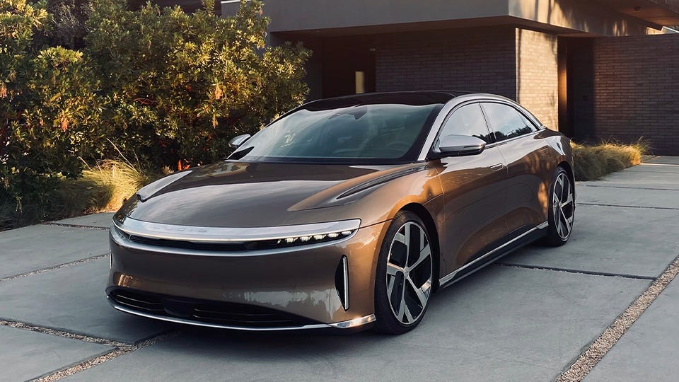

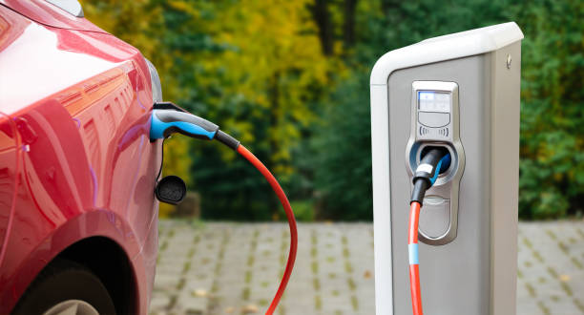
Electrifying the road to sustainability
Team Electric Blue
Hong Phuc Nguyen
Urvi Vadiya
Zarin Raihana

Slide 3
Problem statement
Strategic placement of L2 chargers and Electrical outlets to support L2 charging
We recommend strategic placement of L2 chargers and L2 supported electrical outlets to addresses this problem which will encourage people to buy ZEVs.
California aims to reach its sustainability goals by promoting the adoption of Electric Vehicles.
At present the charging capability in California does not meet the demands of the EV market
* Although ZEVs include all alternative fuels including hydrogen fuel cell, we will assume they will all be electric vehicles for the purpose of our analysis.

Slide 4
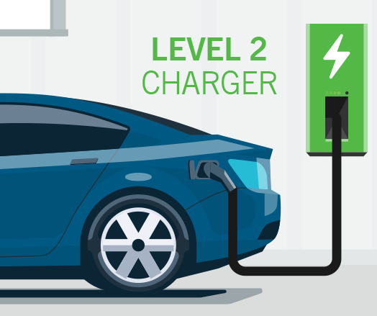
Why Level 2 Chargers
The median household income in California is $ 84,907 and the median price of a house is $829,760². Many Californians live in rental homes and lack access to reliable L2 charging options which dissuades new buyers from purchasing a ZEV.
Studies show the negative effects of DC fast charging on long-term battery life. Not only is replacing a battery expensive it also comes with an environmental cost. Therefore, it is important to have access to L2 chargers in order to reduce the turnover of EV batteries.
Our solution is to install additional public L2 chargers and provide access to electrical outlets that support L2 charging with a personal mobile connector which can be purchased with the car at nominal cost.
https://www.geotab.com/blog/ev-battery-health/

Slide 5
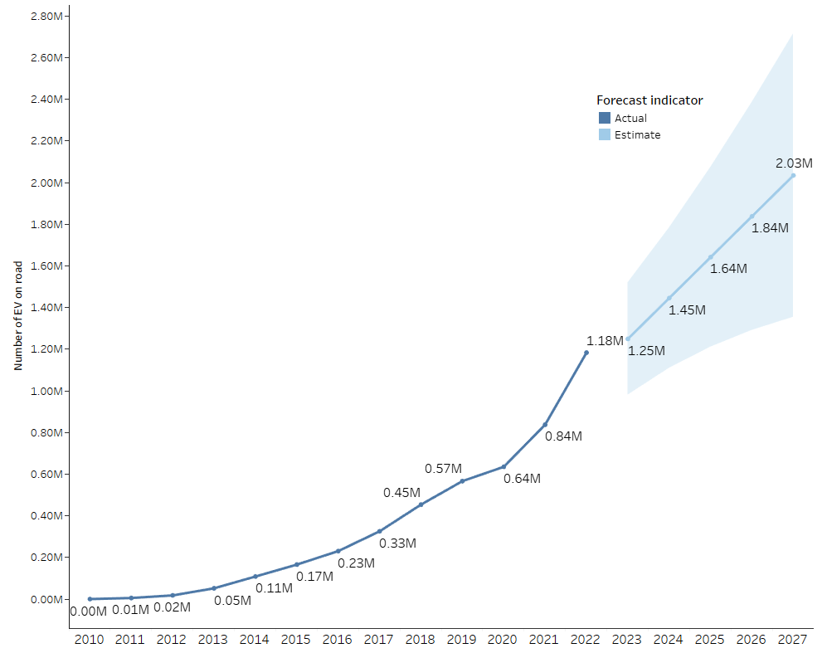
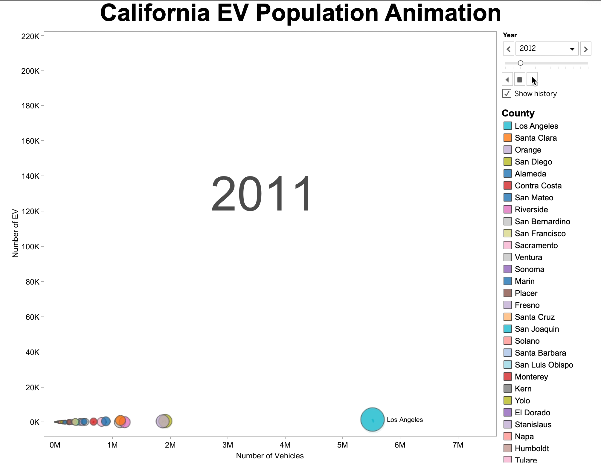
Forecasted evS in California

Slide 6
Research Analysis
Average cost of a mobile connector is $200
California has a 2023 budget of $81,720,595 for Electric Vehicle Charging
Average cost of an electric vehicle is $56,437
On average, 1 charger is required per 13 EVs¹
https://driving.ca/column/motor-mouth/motor-mouth-how-many-ev-charging-stations-will-we-really-need
Budget 2023: https://www.fhwa.dot.gov/bipartisan-infrastructure-law/evs_5year_nevi_funding_by_state.cfm
https://ev-lectron.com/collections/ev-adapters
https://www.cnbc.com/2021/12/29/electric-vehicles-are-becoming-more-affordable-amid-spiking-gas-prices.html

Slide 7
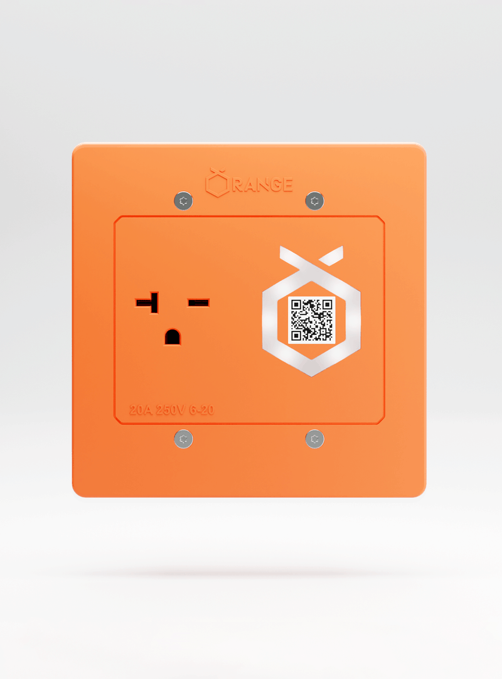
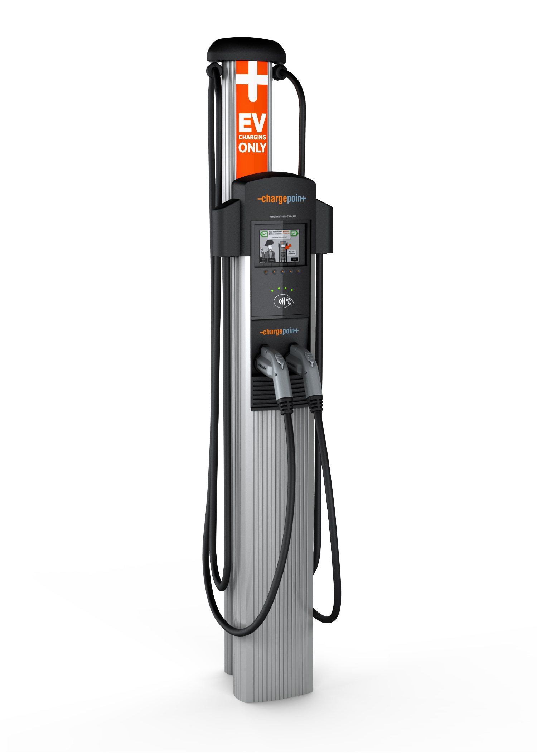
Our Solution
L2 outlet
L2 Charger
Today most of the L2* chargers are units whose average cost is $2,200 per unit.
The cost of installing an electrical outlet that supports L2 charging is $400 per unit.
Our solution is to increase access to L2 charging by installing a mix of these two types of charging options.
This will lower installation costs
We will implement our new solution in one county with the highest disparity between the number of EV cars and L2 chargers.
This will help us evaluate our solution at micro level which can then be scaled and applied at a macro level to all of California.
* L2 chargers are slow chargers that use AC current.
https://www.cnbc.com/2021/12/29/electric-vehicles-are-becoming-more-affordable-amid-spiking-gas-prices.html
Average cost to install a L2 charger $2200: https://blog.carvana.com/2021/07/how-much-does-it-cost-to-install-an-ev-charger/
Average Cost of installing an electrical outlet to support L2 charging: https://www.orangecharger.com
Notes:
https://pixabay.com/en/construction-worker-saw-concrete-646918/

Slide 8
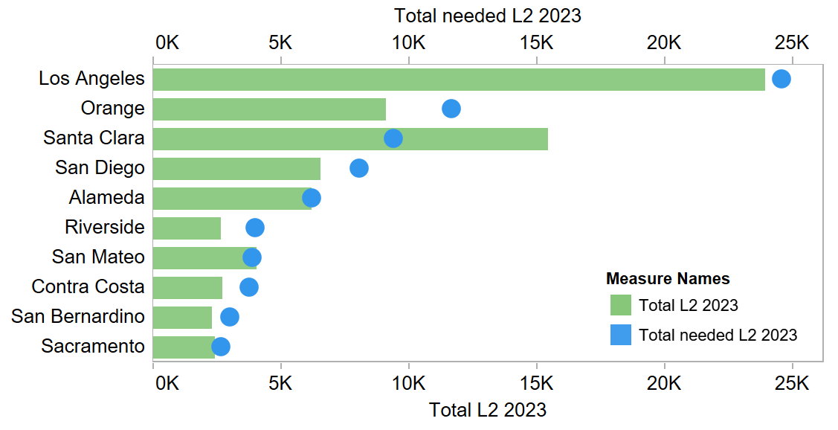
disparity of L2 chargers per county
We will apply our proposed solution to Orange County as it has the highest disparity between number of EV cars and L2 chargers.
We propose a 70/30 split between traditional L2 chargers and Electrical outlet to support L2 charging.

Slide 9
Required level 2 Chargers FOR 2023 top 10 counties
Calculation detail:
(3) = (1)/(2) (4) = (1)*1.25/1.18 (5) = (4)/13 (average 13 EV / charger) (6) = (5) – (2)
(7) = $81,720,595 * Need_to_add_L2 / Sum(Need_to_add_L2) (8) = 0.7*(7) (9) = 0.3*(7)
(10) = (8)/2,200 ($2,200 per L2 charger) (11) = (9)/400 ($400 per outlet) (12) = (2) + (10) + (11) (13) = (4)/(12)
https://driving.ca/column/motor-mouth/motor-mouth-how-many-ev-charging-stations-will-we-really-need
Number of EV 2022: https://www.energy.ca.gov/files/zev-and-infrastructure-stats-data
Level 2 2022: https://afdc.energy.gov/data_download
Budget 2023: https://www.fhwa.dot.gov/bipartisan-infrastructure-law/evs_5year_nevi_funding_by_state.cfm

Slide 10
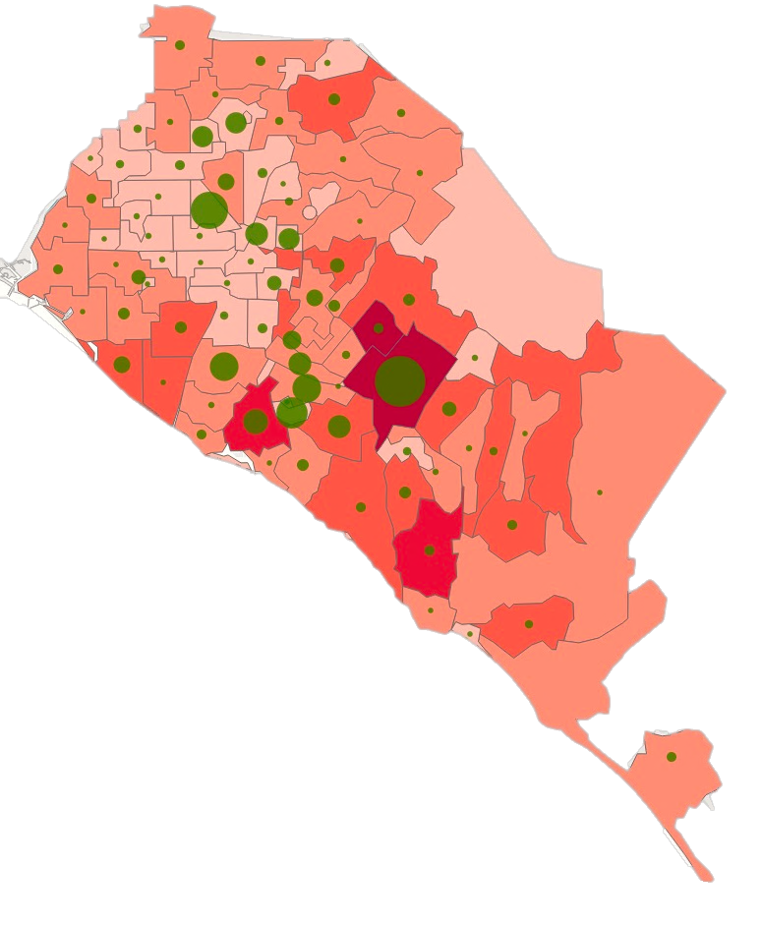

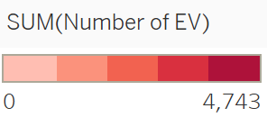
Uneven distribution of Ev Stations
92831
801 EV | 39 EV Stations
92802
455 EV| 138 EV Stations
92677
3,063 EV | 12 EV Stations
92646
1,752 EV | 2 EV Stations

Slide 11

ZIP CODES TO CONSIDER FOR NEW L2 CHARGERS
92886 |
2,408 EV | 14 EV Stations
92620 |
3,690 EV | 10 EV Stations
92677 |
3,063 EV | 12 EV Stations
92646 |
1,752 EV | 2 EV Stations

Slide 12
Installation Plan 24,189 chargers (5,851 L2 chargers and 13,791 L2 OutletS) in ORANGE COUNTY 2023

Slide 13
OUR Recommendation
Installing L2 Chargers/Outlets
Installing L2 outlets and charging units in centralized public parking structure for Dense neighborhood
Installing L2 outlets in multi-family dwelling units and Workplace parking structure
Installing L2 outlets and Charging units in commercial complex and malls
COORDINATING WITH PRIVATE COMPANIES TO EXPAND INSTALLTIONS WHERE POSSIBLE

Slide 14
Impact of Implementing Recommendations
Increased availability of L2 charging and attracting more EV buyers
Providing equal L2 charging access to low-income neighborhood
Will reduce the number of gas cars and the carbon footprint
Reducing the cost of installing and maintaining L2 chargers

Slide 15
OUR Projected TIMELINE
Q1 2023
Q2 2023
Q3 2023
Q4 2023
Project approval
Identify locations
Install charging outlets
Test and commercialize

Slide 16
Thank you!

Slide 17





Data sources-Appendix
Vehicles population since 2010
Number of level 2 chargers and locations
Budget for ev segments 2022 - 2026
Population, housing, median income since 1980
California zip codes

